Slide 1
Self-management in your studies
Tutor*in: Sahra, Ina, Merle
12.11.2025

Slide 2
Agenda
Expectations
Time Management
Getting things done
Notion

Slide 3
What do you expect to happen in your first semester?
Notes:
To You: Ask the students about their expectations. If the response is little, try specifying for example exam phase and workload. If not mentioned, ask for differences regarding their secondary school and other comparable experiences.

Slide 4
Experiences of previous first-year students
What you can expect
More independence & responsibility
Homesickness - but also the chance to meet great new people and try things out for yourself
Exciting experiences in your studies, work and free time - finding a balance
Initial lack of clarity (Moodle, myStudy etc.) will give with time
It can get stressful at times... but you will master that too
Regular attendance at the tutorial saves a lot of time and effort and makes it easier to get started!
Notes:
To you: Some classic reflections after the first semester are already listed here, add your own if necessary. Try not to frame the points as gloomy prophecies, but rather as situations that could possibly occur. If this is the case, then the first-year students are definitely not alone in this; many others are experiencing this and students before them have done so too. Please emphasize the last point in particular. Of course, you can't prevent some students from no longer coming to the tutorial. But try to convey the value of the tutorials and how they help first-year students to overcome the challenges that await them. We are convinced that the absence from tutorials will lead to considerable additional work and make the start of the semester unnecessarily difficult. Meaningful content is covered that is selected by students themselves.

Slide 5
Why time management matters!
Deliberate planning and use of time
Use your time better for university, work and private stuff
Reduce your stress level to a minimum
Reaching your academic and personal goals
Notes:
Time management

Slide 6
Discipline /focus
Learn to say „No“
Self-care
Planning / Structuring / routine
Goal setting
Prioritization
A System
Avoid procrastination
Notes:
To the students: Here are some aspects of effective time management that we find important.

Slide 7
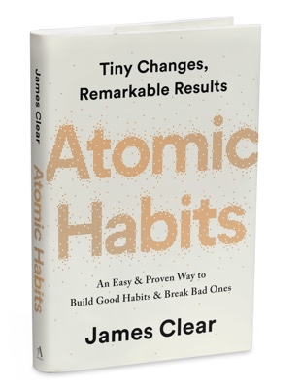

The power of a system
You can be disciplined but still unproductive if you lack a system
A system is a principle according to which something is structured/organized
You have to like the system you follow in order to be efficient!
you don‘t rise to the level of your goals,
you fall to the level of your systems
— James Clear, Atomic Habits
Notes:
To the students: You're always smarter afterwards and it's okay to miscalculate a lot of things in the first semester and also in the second semester, it's going to happen one way or another. You can save yourself stress and leave the others amazed if you follow the tips of higher semester students right from the start. This doesn't mean in the slightest that the typical student/social life has to take a back seat. In fact, you will have more free time if you increase your efficiency.
The most important thing is a systematic approach. This basically just means that you have an order where input and output are clearly regulated and organized. Whether the system is digital or analog, simple or complicated is up to you. You have to like the system so that it works for you.

Slide 8
Getting things done (David Allen)
  CAPTURE
  every commitment in your life in a trusted place outside your head (like a software
  program or a piece of paper)
  CLARIFY exactly what each commitment is, the desired
  outcome of fulfilling it, and only
  the very next
  action required
  ORGANIZE reminders of
  these actions in form of a Project List
  REFLECT
on your list on a weekly basis to make sure it’s
clear, current, and complete
EXECUTE on your actions by making intuitive decisions about what to do next, trusting your
system to not let anything fall through the
cracks
Source: https://evernote.com/blog/getting-started-with-gtd-templates/
Notes:
To the students: 5 principles you can follow in your organizational system. There are also other guidelines.
As far as “capturing” is concerned, we recommend always leaving the email inbox empty. This means not only marking emails as read, but also creating a task based on the content of the email (if applicable). If the task can be completed in less than two minutes, it should be completed immediately and the email deleted. This way, you will never forget an email again. “Inbox Zero” is perfectly transferable to other areas of life and helps you stay organized and clear your head.
To you: Feel free to tell us here what your own system looks like or give an example to give a more concrete idea of what an organizational system could look like.

Slide 9
What organizational and time management methods do you use?
Notes:
To you: Encourage the exchange of organizational and time management methods among the students.

Slide 10
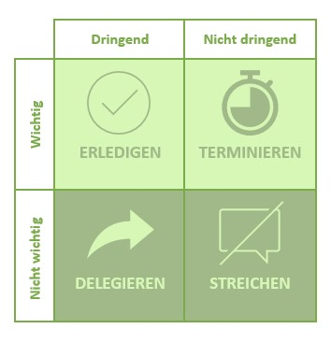
Tips & Personal experiences
To-do list
Eisenhower matrix
Visualize your time
Separation of living and working space
Time blocking in the calendar
Pomodoro: 25 min work, 5 min break
Networking
Have fun…
urgent
not urgent
important
COMPLETE
SCHEDULE
not important
DELEGATE
CROSS OUT
Source: https://www.orghandbuch.de/Webs/OHB/DE/OrganisationshandbuchNEU/4_MethodenUndTechniken/Methoden_A_bis_Z/Eisenhower_Matrix/Eisenhower_Matrix_node.html
Notes:
To you: Encourage exchange and present and collect ideas and experiences on the topic of self-organization during your studies. Share your own tips as a tutor. We have already started a list here, feel free to add to it. Ask for suggestions from which everyone can choose what works for them (e.g. to the students: We are collecting a few organizational strategies here that you can try out. In the end, you should pick what works for you. You're not stupid or lazy if a popular strategy doesn't work for you. Just try something else again!)
To-do list: simple but effective; tip: a list with everything you can think of and one with the 1-3 most important things you want to do today
Eisenhower matrix: good for prioritizing; depending on whether the task is urgent and/or important, it is treated differently
Time blocking: schedule blocks in the calendar for focused work, organization, but also leisure activities
Pomodoro method: set a timer for 25 minutes and work, then take a 5-minute break (there are also apps that restrict cell phone use during this time); the exact length can of course be changed depending on your own workflow, e.g. some people prefer to work for 50 minutes at a time

Slide 11

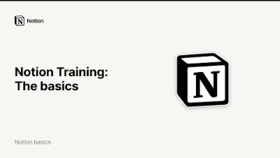
Notion, the all-in-one workspace
Click here to get the Leuphana Semester Template
Notes:
To the students: System, system - what kind of system? Sounds like a computer program... But it doesn't have to be. And don't worry, you don't have to program anything. If you prefer a physical calendar and are comfortable keeping your to-do's in paper form, then go for it. But there are plenty of advantages to a digital approach and very few disadvantages. We recommend giving the Notion app a try. The program has been flourishing for students for a few years now and combines a writing program, calendar, to-do list and much more. What's more, the app costs nothing for Leuphana students and there is a template that was created especially for the Leuphana semester.

Slide 12
Mitschreiben, Vor- und Nachbereitung von Vorlesungen
Before the lecture:
Read texts
Download slides (if available)
Write down questions
Take notes during the lecture:
On paper / laptop (e.g. Notion, MS Word) / tablet (e.g. GoodNotes)
Add slides (if slides are available)
Not everything, just the important stuff!
Think for yourself
Follow-up:
If necessary, convert notes into legible form
Clarify gaps in understanding (internet research, ask fellow students)
Create notepads, index cards etc. to prepare for the exam
Make sample exercises (if available)
Tip: Ask yourself questions
Why is this important? What is the main message?
Notes:
To the students: You learn to distinguish the important from the unimportant from facts and information. It can help to ask questions such as “Why is the topic important?” or “What is the main message?”, as this allows you to keep the bigger picture in mind and take notes based on it. It might also help to pay attention to what the professor is focusing on. You learn the most when you really have to use your brain when taking notes, because you formulate things yourself, try to understand, recognize connections,...

Slide 13
Verwandte Wiki Artikel
Studying: https://sustainabilitymethods.org/index.php/Studying
Pomodoro: https://sustainabilitymethods.org/index.php/Pomodoro
Notion: https://sustainabilitymethods.org/index.php/Notion
Coping with psychological problems: https://sustainabilitymethods.org/index.php/Coping_with_psychological_problems
Notes:
To You: a collection of Wiki articles for further information

